Slide 1


Sorting
Insertion Sort
7th May,2015
Soumyadeep Roy
2nd year,CSE
Kalyani Government Engineering College

Slide 2
Challenge
“Over the years, there has always been a gap between the logical thinking and programming ability of the students.
And I don't mean mathematical thinking, I mean turning ideas into codes. ”
- Dr. Siu-Wing CHENG

Slide 3

Sorting
Bubble Sort
Selection Sort
Insertion Sort
Merge Sort
Heap Sort
Quick Sort
Shell Sort
Counting Sort
Radix Sort ...
Order of SORTING:
Ascending
Non-decreasing
Descending
Non-increasing

Slide 4
Example of insertion sort
8
2
4
9
3
6

Slide 5
Example of insertion sort
8
2
4
9
3
6

Slide 6
Example of insertion sort
8
2
4
9
3
6
2
8
4
9
3
6

Slide 7
Example of insertion sort
8
2
4
9
3
6
2
8
4
9
3
6

Slide 8
Example of insertion sort
8
2
4
9
3
6
2
8
4
9
3
6
2
4
8
9
3
6

Slide 9
Example of insertion sort
8
2
4
9
3
6
2
8
4
9
3
6
2
4
8
9
3
6

Slide 10
Example of insertion sort
8
2
4
9
3
6
2
8
4
9
3
6
2
4
8
9
3
6
2
4
8
9
3
6

Slide 11
Example of insertion sort
8
2
4
9
3
6
2
8
4
9
3
6
2
4
8
9
3
6
2
4
8
9
3
6

Slide 12
Example of insertion sort
8
2
4
9
3
6
2
8
4
9
3
6
2
4
8
9
3
6
2
4
8
9
3
6
2
3
4
8
9
6

Slide 13
Example of insertion sort
8
2
4
9
3
6
2
8
4
9
3
6
2
4
8
9
3
6
2
4
8
9
3
6
2
3
4
8
9
6

Slide 14
Example of insertion sort
8
2
4
9
3
6
2
8
4
9
3
6
2
4
8
9
3
6
2
4
8
9
3
6
2
3
4
8
9
6
2
3
4
6
8
9
done

Slide 15

Insertion sort
Divides the array into two region -The sorted portion to the left and the unsorted portion to the right.
Properties:
Stable (Order of same elements remains the same)
No extra memory is required.
O(n²): Takes a maximum of n-squared comparisons and swaps, where n is the input size.
Adaptive: O(n) time when nearly sorted
Application:
Sorting a nearly sorted sequence of elements.

Slide 16
Implementation in C
Storing user input in an array of size ‘list’
int list,i,j,key;
scanf( "%d“ , &list);
int arr[list];
for(i=0;i<list;i++)
scanf( "%d“ , &arr[ i ]);

Slide 17
Implementation in C
The main insertion sort code:
for(j=1;j<list;j++) {
i=j-1;
key=arr[j];
while( i > -1 && arr[i]>key) {
// Shifts greater elements to the right
arr[ i+1 ]=arr[ i ] ;
i--;
}
arr[ i+1 ]=key;
//Places the j-th element in correct place
}

Slide 18
Insertion Sort Code
int list,i,j,key;
scanf( "%d“ , &list);
int arr[list];
for(i=0;i<list;i++)
scanf( "%d“ , &arr[ i ]);
for(j=1;j<list;j++) {
i=j-1;
key=arr[j];
while( i > -1 && arr[i]>key) {
arr[ i+1 ]=arr[ i ] ;
i--;
}
arr[ i+1 ]=key;
}

Slide 19





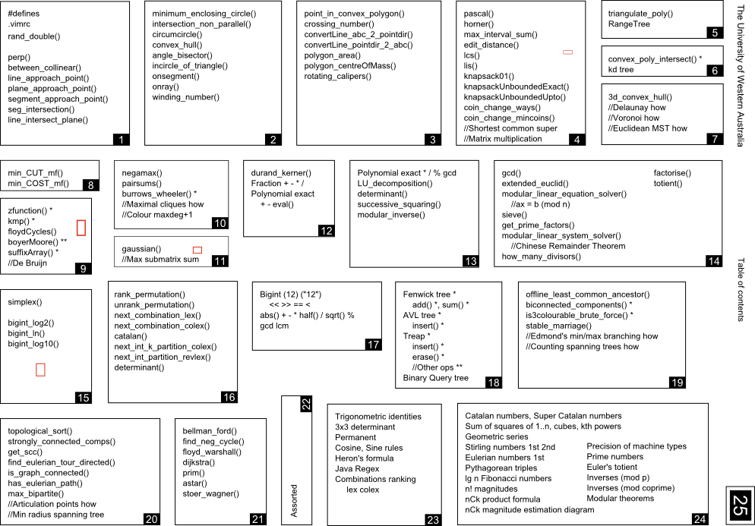



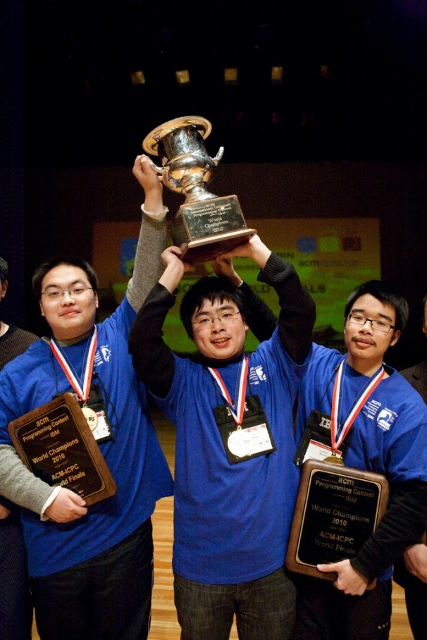

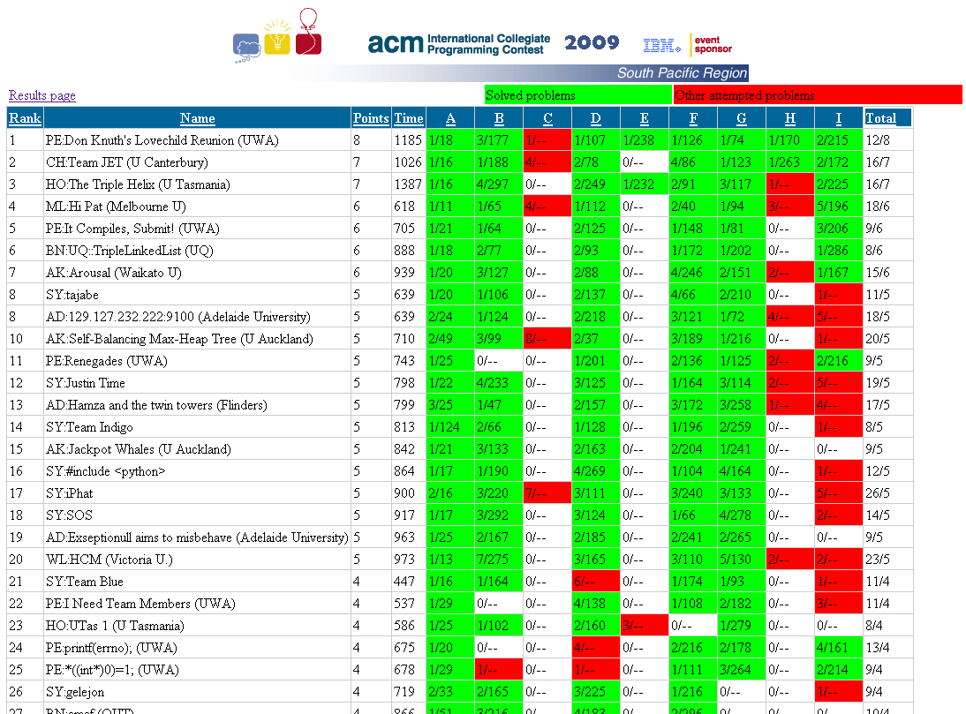






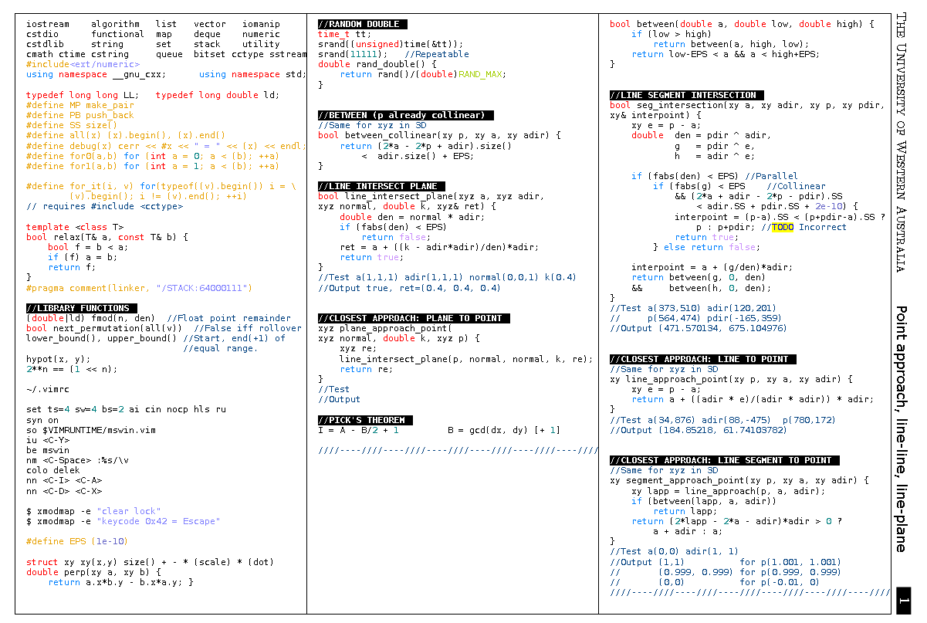
At the 2010 ACM-ICPC World Finals…

